Slide 1


Movie Production Recommendations for Microsoft Studios
Jennifer Cobb
Alex Marshall
Patrick Ryan

Slide 2
Summary
Brand new Microsoft Studios requires a game plan for their initial run of movies. We examined what genres garner the greatest Return on Investment, evaluated the most and least popular genres, and looked at when movies were being released and have determined that Microsoft is best served by releasing X MOVIES in Y PART OF YEAR.

Slide 3
Outline
Business Problem
Data
Methods
Results
Conclusions

Slide 4
Business Problem
Find holes in the market
Get the greatest return on investment
Ensure releases won’t be lost in the crowd

Slide 5
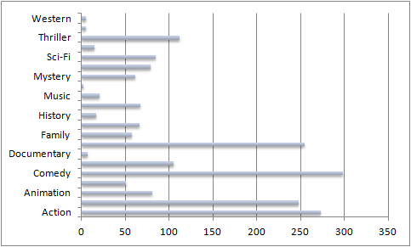
Data
Movie release data from IMDB, The Internet Movie Database, Rotten Tomatoes, collected over a roughly ten-year span.
Includes movies’ budget, box office, studio, and genre.

Slide 6
Methods
Linked data from multiple sources
Determined ROI and profit using available financial data
Group data by genre and studio
PICTURE OF DATAFRAME WITH ROI COLUMN

Slide 7
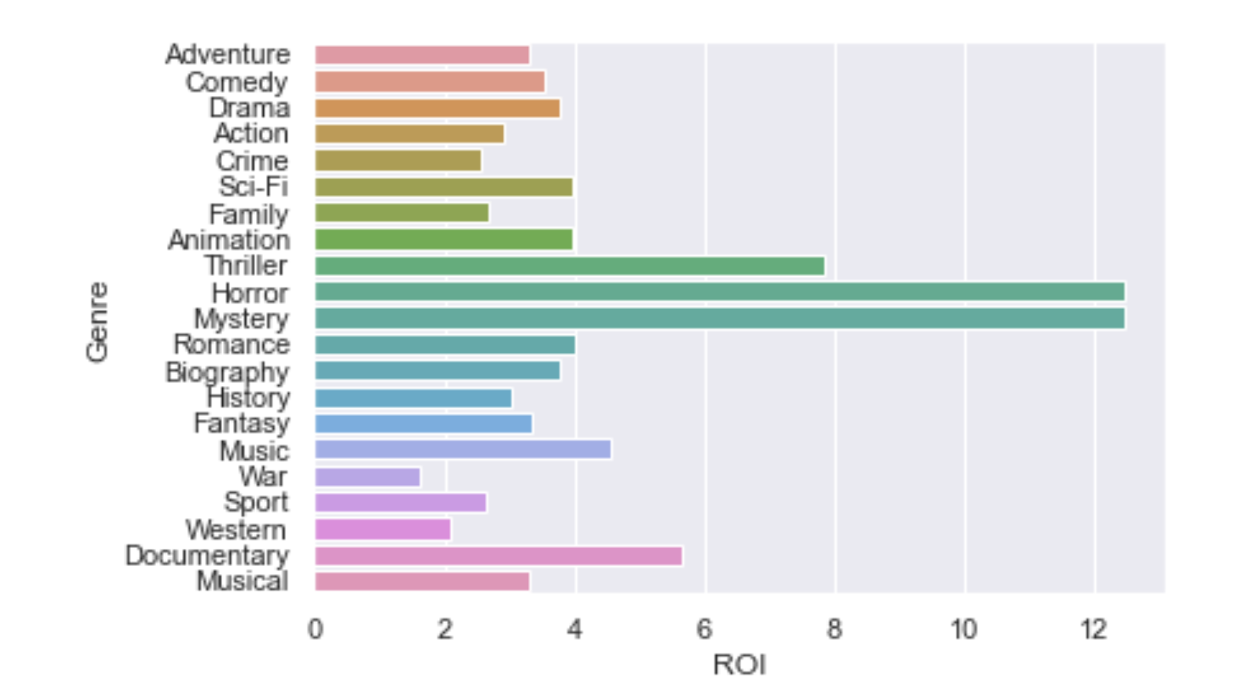
Results
The separation between the first genre and the fifth is much more significant than the fifth and twentieth.

Slide 8
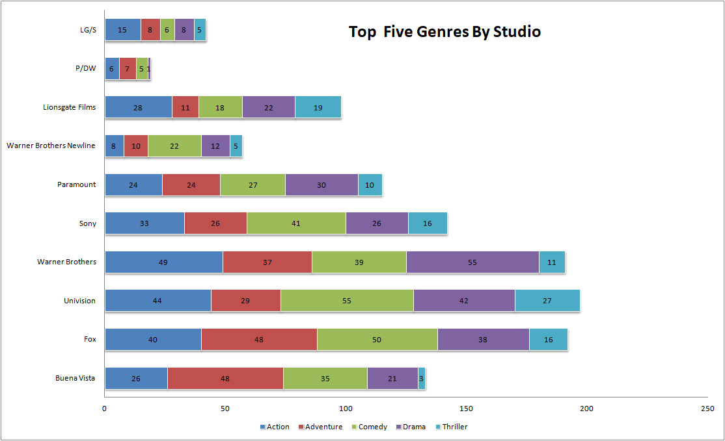
Results
Thriller is the most popular genre with the greatest ROI

Slide 9
Results
Documentary is least produced with highest ROI

Slide 10
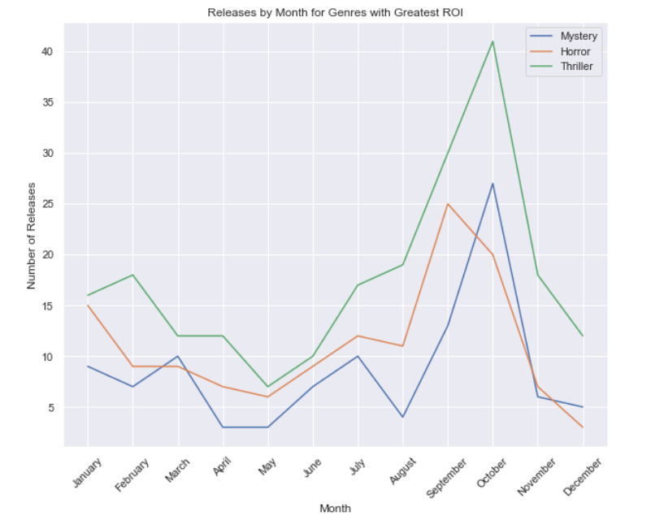
Results
Fewest movies released at the end of the year with another dip in releases over April & May.

Slide 11
Conclusions
As a new production company, Microsoft should focus on the best return for their product. This will ensure revenue for future products.
Release schedule should take advantage of end of year and late spring lulls in order to maximize visibility of product. Limited competition requires decreased marketing budget for these offerings.

